Slide 1

Best Restaurant near UC Hastings College of the Law
Applied Capstone Project
Author: Letian Ma

Slide 2
Background
When we move into a new environment, we often would like to familiarise ourselves with the surroundings and check out places of interests.
Among the places of interests, food is important to many.
This project focuses on finding out the best restaurant in the vicinity of the campus in the proximity of UC Davis, San Francisco Campus using Foursquare data.
Based on the definition of our problem, the analysis will be based on the following two criteria:
High ratings (Min 8.0)
Within proximity to the UC Hastings College of the Law (300 meters or 1000 metres)

Slide 3
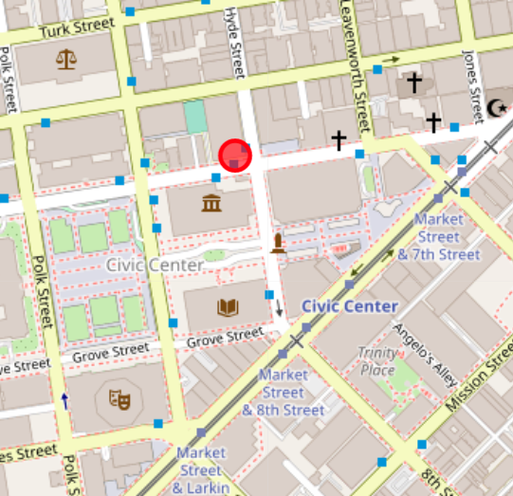
Location of UC Hastings College of the Law

Slide 4
Data Sources
The following information will be extracted from external sources:
The latitude and longitude of UC Hastings College of the Law will be extracted using geocoding web services offered by geopy
The restaurants' data and location will be extracted using Foursquare API
We look at the restaurants within 300 metre radius first before looking at restaurants within 1000 metre radius.

Slide 5
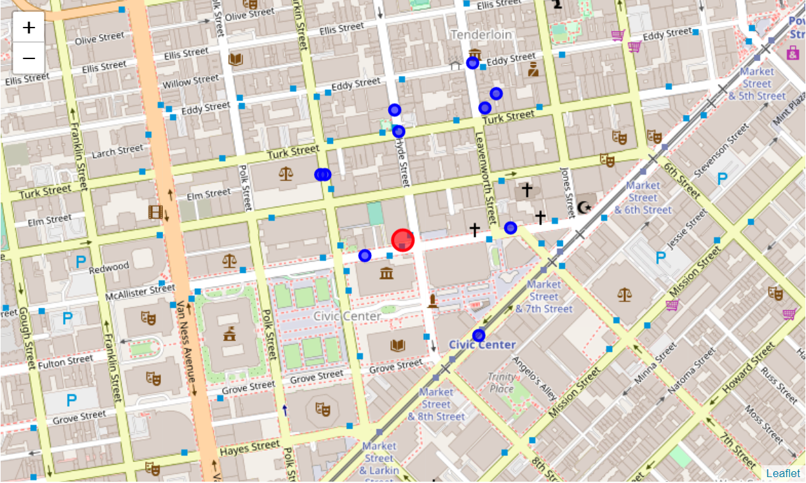
Restaurants within 300 metres radius
Blue Markers: Restaurants
Red Marker: UC Hastings College of the Law

Slide 6
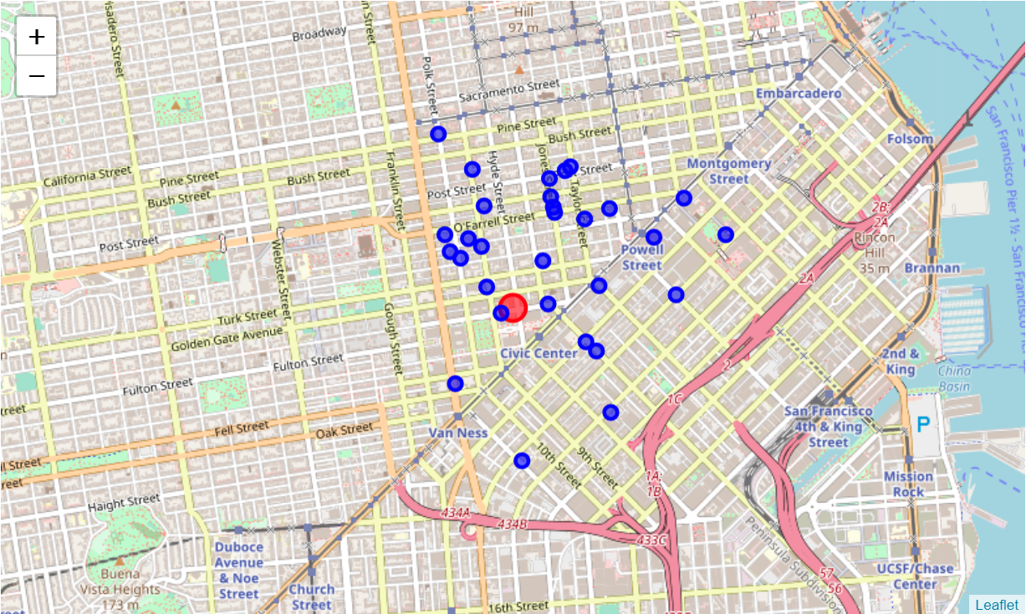
Restaurants within 1000 metres radius
Blue Markers: Restaurants
Red Marker: UC Hastings College of the Law

Slide 7
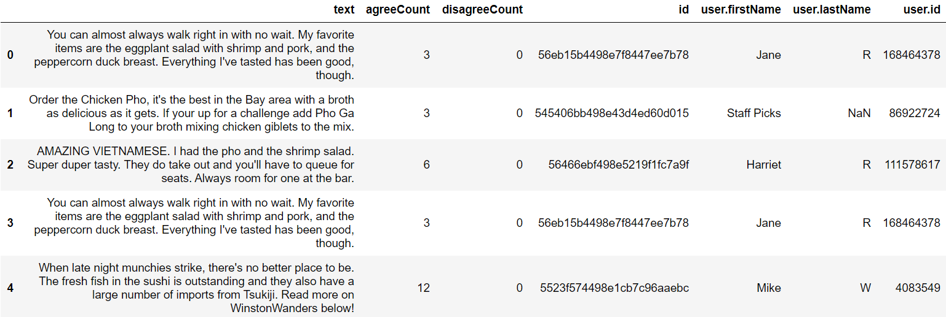
Results and Discussions

Slide 8
Results and Discussions
From the reviews, two observations could be made.
There is a growing trend of popularity for Asian Food in San Francisco
The reviews from the top options are quite decent, which are not surprising considering they are the top options.
Hence, they could all be recommended and users need to weight how much time they want to spend travelling

Slide 9
Conclusions
This list of restaurants could be recommended to the interested students.
Reduce stakeholders' search cost
The final decision on the most optimal restaurant will depend on the subjectivity of the stakeholders, just like many real-life scenarios.

Slide 10
Future Directions
There are many more factors that can be taken into consideration when conducting this project.
A more scientific approach could be taken to define and fine-tune the metrics used to measure the 'best restaurant’.
Compare the average rating of restaurants in San Francisco instead of using a self-defined 8.0
More metrics such as quality of service, quality of food, cleanliness, etc.
Text mining could be done for sentiment analysis
Lastly, if I could pull more reviews from the query, it will provide a more balanced look at the restaurants

